Slide 1

Welcome to Bible Class
欢迎参加圣经课程
The Messiah in the Old Testament
旧约中的弥赛亚

Slide 2


Slide 3
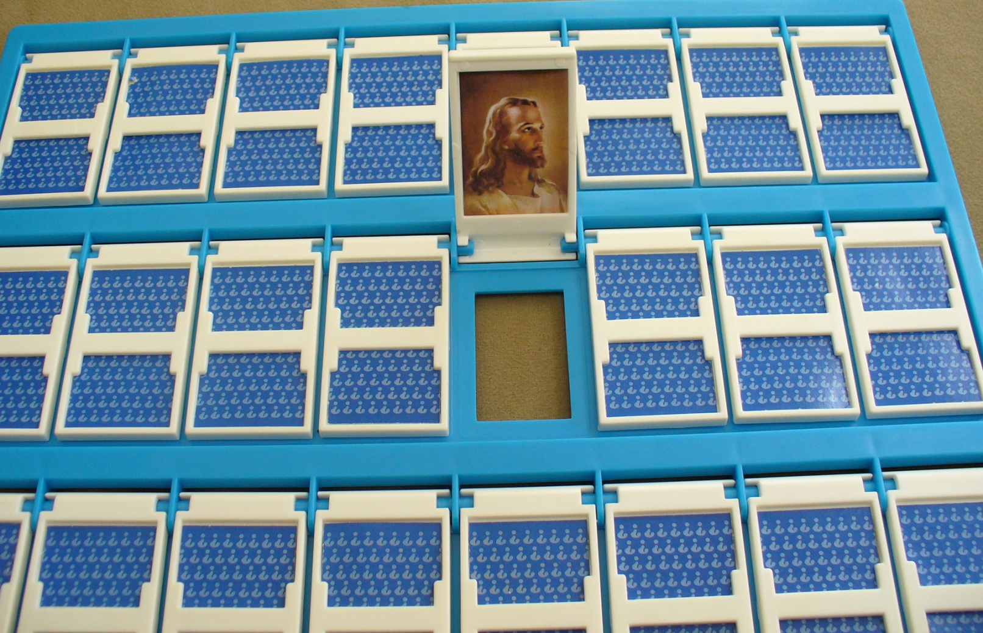

Slide 4

Part 3
第三部分
THE MESSIAH IN THE PSALMS
诗篇中的弥赛亚
Lesson 9 = The Messiah Does God’s Will (Psalm 40)
第九课=弥赛亚行神的旨意（诗40）
Lesson 10 = The Messiah is Crucified (Psalm 22)
第十课=弥赛亚被钉十字架（诗22）
Lesson 11 = The Messiah is the Risen Lord (Psalm 16)
第十一课=弥赛亚是复活的主（诗16）
Lesson 12 = The Messiah is the King of Glory (Ps 2 & 110)
第十二课=弥赛亚是荣耀的君王（诗2及诗110）

Slide 5
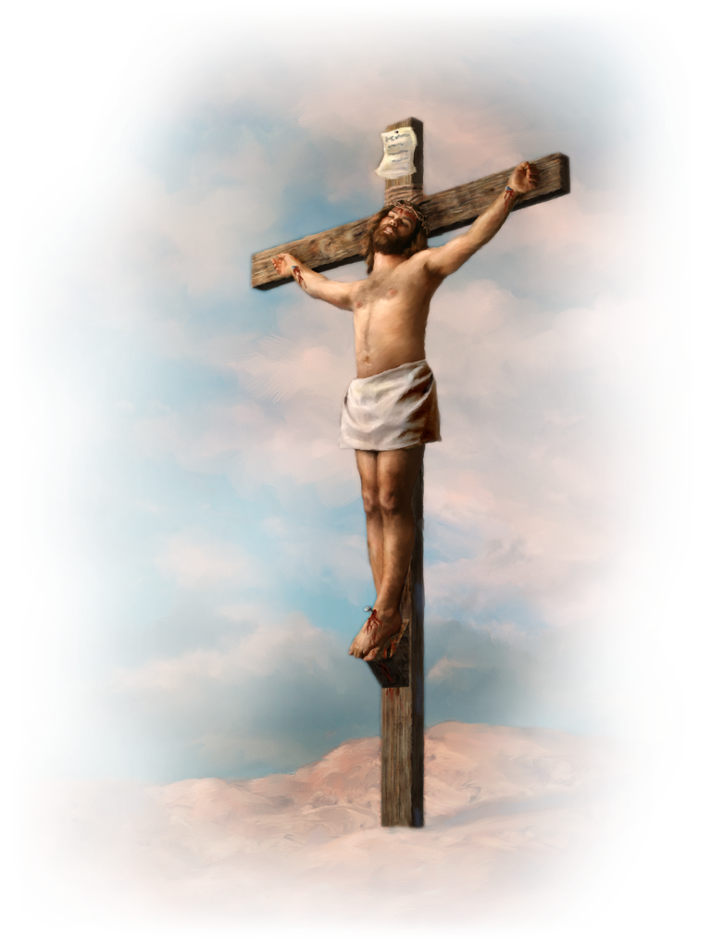
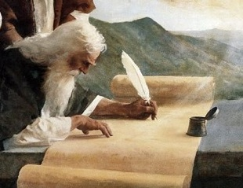

Slide 6
PSALM 22
诗22
A. vv. 1-21 = The Messiah’s lament over his extraordinary suffering
第1-21节=弥赛亚因极度痛苦而哀痛
B. vv. 22-31 = The Savior’s hymn of praise for his deliverance
第22-31节=救主因得救而赞美

Slide 7
Amazing Details of the Passion 受难的奇妙细节
Psalm 22 诗22 | Jesus’ Passion 耶稣受难
1 -- My God, my God, why have you forsaken me? Why are you so far from saving me, so far from the words of my groaning? 1—我的神，我的神，为什么离弃我。为什么远离不救我，不听我唉哼的言语。 | Matthew 27:46 -- About the ninth hour Jesus cried out in a loud voice, “Eloi, Eloi, lama sabachthani?”—which means, “My God, my God, why have you forsaken me?” 太27:46—约在申初，耶稣大声喊着说，以利，以利，拉马撒巴各大尼？就是说，我的神，我的神，为什么离弃我？
7-- All who see me mock me; they hurl insults, shaking their heads: 7—凡看见我的都嗤笑我。他们撇嘴摇头，说， | Matthew 27:39 -- Those who passed by hurled insults at him, shaking their heads 太27:39—从那里经过的人，讥诮他，摇着头说
11 -- Do not be far from me, for trouble is near and there is no one to help. 11—求你不要远离我。因为急难临近了，没有人帮助我。 | Matthew 26:56 -- But this has all taken place that the writings of the prophets might be fulfilled.” Then all the disciples deserted him and fled. 太26:56—内中有抹大拉的马利亚，又有雅各和约西的母亲马利亚，并有西庇太两个儿子的母亲。

Slide 8
Amazing Details of the Passion 受难的奇妙细节
Psalm 22 诗22 | Jesus’ Passion 耶稣受难
15 -- My tongue sticks to the roof of my mouth; you lay me in the dust of death. 15—我的精力枯干，如同瓦片。我的舌头贴在我牙床上。你将我安置在死地的尘土中。 | John 19:28 -- Later, knowing that all was now completed, and so that the Scripture would be fulfilled, Jesus said, “I am thirsty.” 约19:28—这事以后，耶稣知道各样的事已经成了，为要使经上的话应验，就说，我渴了。
16 -- Dogs have surrounded me; a band of evil men has encircled me, they have pierced my hands and my feet. 16—犬类围着我。恶党环绕我。他们扎了我的手，我的脚。 | Luke 23:33 -- When they came to the place called the Skull, there they crucified him. 路23:33—到了一个地方，名叫髑髅地，就在那里把耶稣钉在十字架上。
18 -- They divide my garments among them and cast lots for my clothing. 18—他们分我的外衣，为我的里衣拈阄。 | Matthew 27:35 -- When they had crucified him, they divided up his clothes by casting lots. 太27:35—他们既将他钉在十字架上，就拈阄分他的衣服。

Slide 9
For the director of music. To the tune of “The Doe of the Morning.” A psalm of David. 大卫的诗，交与伶长。调用朝鹿。
Is this David or Jesus speaking? 说这话的是大卫还是耶稣？
Psalm 22:22 -- I will declare your name to my brothers; in the congregation I will praise you. 诗22:22—我要将你的名传与我的弟兄。在会中我要赞美你。 | Hebrews 2:11-12, 14 -- Both the one who makes men holy and those who are made holy are of the same family. So Jesus is not ashamed to call them brothers. He says, “I will declare your name to my brothers; in the presence of the congregation I will sing your praises.” Since the children have flesh and blood, he too shared in their humanity so that by his death he might destroy him who holds the power of death—that is, the devil. 来2:11-12,14—因着信，连撒拉自己，虽然过了生育的岁数，还能怀孕。因他以为那应许他的是可信的。所以从一个仿佛已死的人就生出子孙，如同天上的星那样众多，海边的沙那样无数。说这样话的人，是表明自己要找一个家乡。

Slide 10
HOW TO UNDERSTAND THIS PSALM 如何理解这一诗篇
The first view is that this psalm is about the struggles of David personally, the struggles of the nation, Israel; or the struggles of some other man.
乍一看这首诗篇所写的是大卫的私人挣扎，以色列民族的挣扎；或者其他人的挣扎
The second view is that this psalm has a dual fulfillment – as a depiction of the struggles of someone at the time of David and the sufferings of the Messiah.
再思量这一诗篇是双重应验—一是大卫王时期某个人的挣扎，二是弥赛亚的受苦
This Psalm refers to the Messiah directly and no other.
这一诗篇直接指向弥赛亚，不是其他人

Slide 11
PSALM 22:1-2 诗22:1-2
¹ My God, my God, why have you forsaken me? Why are you so far from saving me, so far from the words of my groaning? ² O my God, I cry out by day, but you do not answer, by night, and am not silent.
1我的神，我的神，为什么离弃我。为什么远离不救我，不听我唉哼的言语。2我的神阿，我白日呼求，你不应允。夜间呼求，并不住声。
“Your iniquities have separated you from your God; your sins have hidden his face from you, so that he will not hear” (Isaiah 59:2).
“但你们的罪孽使你们与神隔绝，你们的罪恶使他掩面不听你们。”（赛59:2）

Slide 12
PSALM 22:1-2 诗22:1-2
¹ My God, my God, why have you forsaken me? Why are you so far from saving me, so far from the words of my groaning? ² O my God, I cry out by day, but you do not answer, by night, and am not silent.
1我的神，我的神，为什么离弃我。为什么远离不救我，不听我唉哼的言语。2我的神阿，我白日呼求，你不应允。夜间呼求，并不住声。

Slide 13
PSALM 22:3-5 诗22:3-5
³ Yet you are enthroned as the Holy One; you are the praise of Israel. ⁴ In you our fathers put their trust; they trusted and you delivered them. ⁵ They cried to you and were saved; in you they trusted and were not disappointed.
3但你是圣洁的，是用以色列的赞美为宝座的。4我们的祖宗倚靠你。他们倚靠你，你便解救他们。5他们哀求你，便蒙解救。他们倚靠你，就不羞愧。

Slide 14
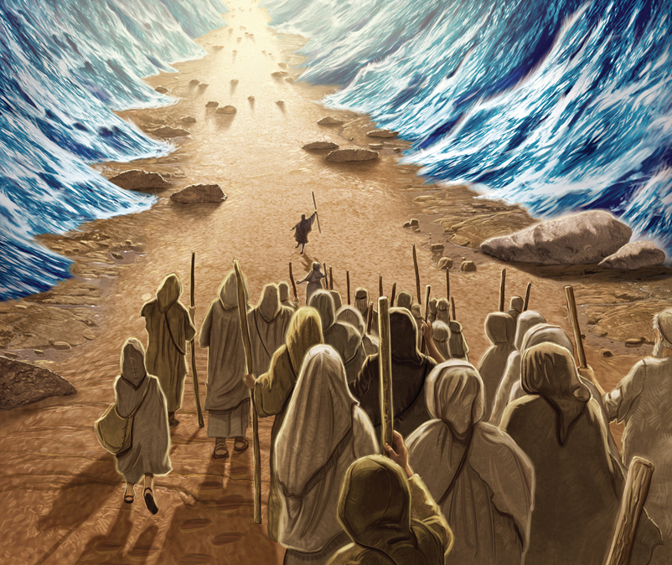
v. 3 “In you our fathers put their trust … and you delivered them” 第4节“我们的祖宗倚靠你……你便解救他们。”

Slide 15
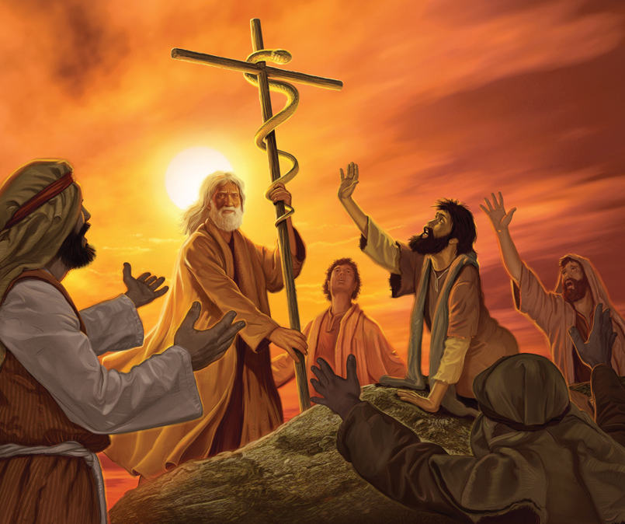
v. 3 “In you our fathers put their trust … and you delivered them” 第4节“我们的祖宗倚靠你……你便解救他们。

Slide 16
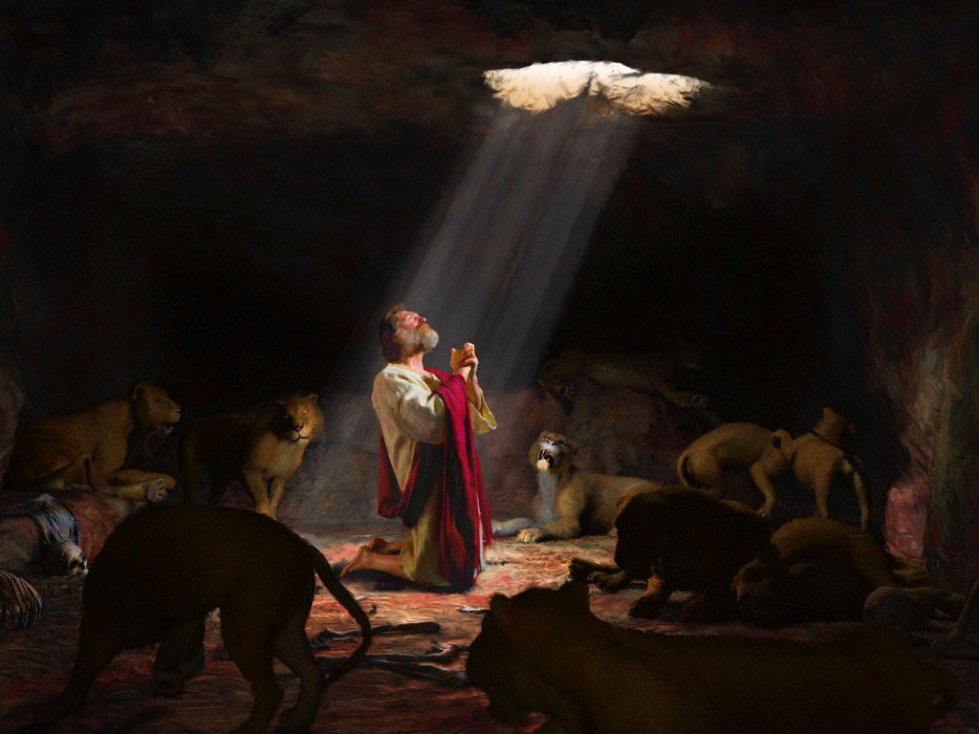
v. 3 “In you our fathers put their trust … and you delivered them” 第4节“我们的祖宗倚靠你……你便解救他们。

Slide 17
PSALM 22:6-10 诗22:6-10
⁶ But I am a worm and not a man, scorned by men and despised by the people. ⁷ All who see me mock me; they hurl insults, shaking their heads: ⁸ “He trusts in the Lord; let the Lord rescue him. Let him deliver him, since he delights in him.” ⁹ Yet you brought me out of the womb; you made me trust in you even at my mother’s breast. ¹⁰ From birth I was cast upon you; from my mother’s womb you have been my God.
6但我是虫，不是人。被众人羞辱，被百姓藐视。7凡看见我的都嗤笑我。他们撇嘴摇头，说，8他把自己交托耶和华，耶和华可以救他吧。耶和华既喜悦他，可以搭救他吧。9但你是叫我出母腹的。我在母怀里，你就使我有倚靠的心。10我自出母胎就被交在你手里。从我母亲生我，你就是我的神。

Slide 18
v. 7 “all who see me mock me; they hurl insults, shaking their heads: “He trusts in the Lord; let the Lord deliver him, since he delights in him.” 第7-8节 凡看见我的都嗤笑我。他们撇嘴摇头，说，他把自己交托耶和华，耶和华可以救他吧。耶和华既喜悦他，可以搭救他吧。
Matthew 27:39-44 -- Those who passed by hurled insults at him, shaking their heads and saying, “He trusts in God. Let God rescue him now if he wants him, for he said, ‘I am the Son of God.’ ”
太27:39-44—从那里经过的人，讥诮他，摇着头说，他倚靠神，神若喜悦他，现在可以救他。因为他曾说，我是神的儿子。

Slide 19
PSALM 22:11-13 诗22:11-13
¹¹ Do not be far from me, for trouble is near and there is no one to help. ¹² Many bulls surround me; strong bulls of Bashan encircle me. ¹³ Roaring lions tearing their prey open their mouths wide against me.
11求你不要远离我。因为急难临近了，没有人帮助我。12有许多公牛围绕我。巴珊大力的公牛四面困住我。13他们向我张口，好像抓撕吼叫的狮子。

Slide 20
PSALM 22:11-13 诗22:11-13
¹¹ Do not be far from me, for trouble is near and there is no one to help. ¹² Many bulls surround me; strong bulls of Bashan encircle me. ¹³ Roaring lions tearing their prey open their mouths wide against me.
11求你不要远离我。因为急难临近了，没有人帮助我。12有许多公牛围绕我。巴珊大力的公牛四面困住我。13他们向我张口，好像抓撕吼叫的狮子。
“Dogs have surrounded me; a band of evil men has encircled me” – verse 16).
“犬类围着我。恶党环绕我。他们扎了我的手，我的脚。”—第16节

Slide 21
What our Savior endured 我们的救主所遭受的痛苦
“All who see me mock me” – v.7
“凡看见我的都嗤笑我”—第7节
“they hurl insults, shaking their heads: ‘He trusts in the LORD; let the LORD rescue him. Let him deliver him, since he delights in him’” – vv. 7-8
“他们撇嘴摇头，说，他把自己交托耶和华，耶和华可以救他吧。耶和华既喜悦他，可以搭救他吧。”—第7-8节
“people stare”- v.17
“他们瞪着眼”—第17节
“people gloat over me” – v.17
“人们对我幸灾乐祸”—第17节
“they divide my garments among them and cast lots for my clothing” – v.18
“他们分我的外衣，为我的里衣拈阄”—第18节

Slide 22
PSALM 22:14-18 诗22:14-18
¹⁴ I am poured out like water, and all my bones are out of joint. My heart has turned to wax; it has melted away within me. ¹⁵ My strength is dried up like a potsherd, and my tongue sticks to the roof of my mouth; you lay me in the dust of death. ¹⁶ Dogs have surrounded me; a band of evil men has encircled me, they have pierced my hands and my feet. ¹⁷ I can count all my bones; people stare and gloat over me. ¹⁸ They divide my garments among them and cast lots for my clothing.
14我如水被倒出来。我的骨头都脱了节。我心在我里面如蜡熔化。15我的精力枯干，如同瓦片。我的舌头贴在我牙床上。你将我安置在死地的尘土中。16犬类围着我。恶党环绕我。他们扎了我的手，我的脚。17我的骨头，我都能数过。他们瞪着眼看我。18他们分我的外衣，为我的里衣拈阄。

Slide 23
PSALM 22:14-18 诗22:14-18
¹⁴ I am poured out like water, and all my bones are out of joint. My heart has turned to wax; it has melted away within me. ¹⁵ My strength is dried up like a potsherd, and my tongue sticks to the roof of my mouth; you lay me in the dust of death. ¹⁶ Dogs have surrounded me; a band of evil men has encircled me, they have pierced my hands and my feet. ¹⁷ I can count all my bones; people stare and gloat over me. ¹⁸ They divide my garments among them and cast lots for my clothing.
14我如水被倒出来。我的骨头都脱了节。我心在我里面如蜡熔化。15我的精力枯干，如同瓦片。我的舌头贴在我牙床上。你将我安置在死地的尘土中。16犬类围着我。恶党环绕我。他们扎了我的手，我的脚。17我的骨头，我都能数过。他们瞪着眼看我。18他们分我的外衣，为我的里衣拈阄。
“Take some of the bull’s blood and put it on the horns of the altar with your finger and pour out the rest of it at the base of the altar.” (Exodus 29:12)
“要取些公牛的血，用指头抹在坛的四角上，把血都倒在坛脚那里。”（出29:12）

Slide 24
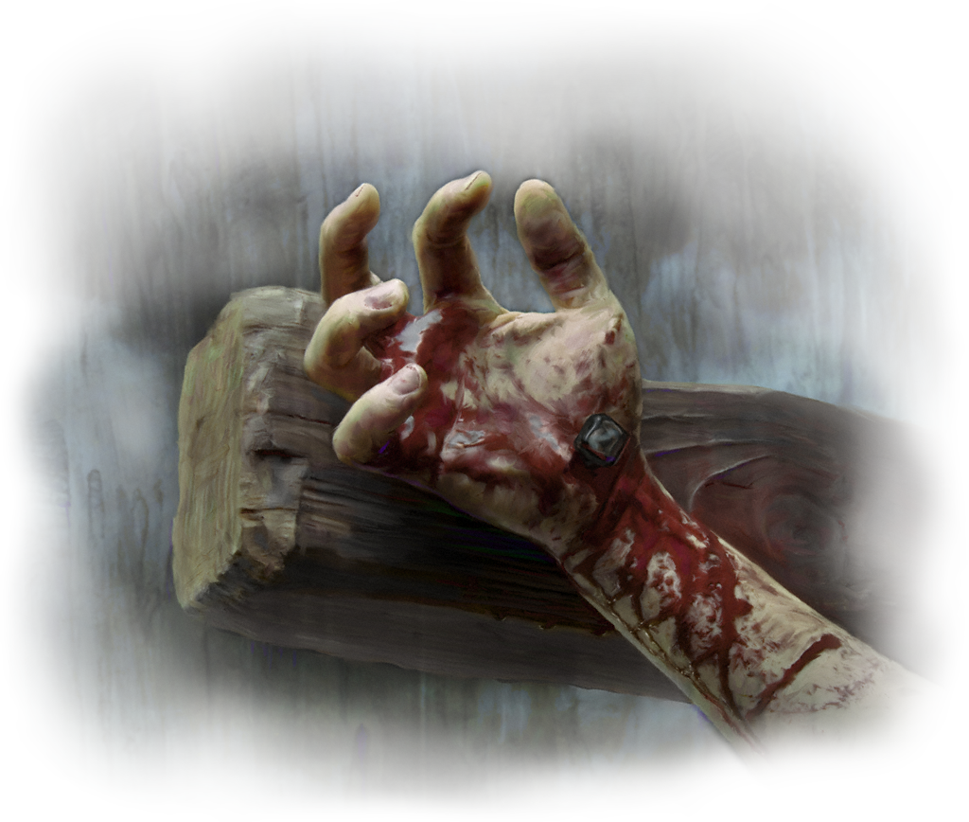
诗22:14-18
¹⁴ I am poured out like water, and all my bones are out of joint. My heart has turned to wax; it has melted away within me. ¹⁵ My strength is dried up like a potsherd, and my tongue sticks to the roof of my mouth; you lay me in the dust of death. ¹⁶ Dogs have surrounded me; a band of evil men has encircled me, they have pierced my hands and my feet. ¹⁷ I can count all my bones; people stare and gloat over me. ¹⁸ They divide my garments among them and cast lots for my clothing.
14我如水被倒出来。我的骨头都脱了节。我心在我里面如蜡熔化。15我的精力枯干，如同瓦片。我的舌头贴在我牙床上。你将我安置在死地的尘土中。16犬类围着我。恶党环绕我。他们扎了我的手，我的脚。17我的骨头，我都能数过。他们瞪着眼看我。18他们分我的外衣，为我的里衣拈阄。
“his appearance was so disfigured beyond that of any man and his form marred beyond human likeness” (Isaiah 52:14)
“他的面貌比别人憔悴，他的形容比世人枯槁”（赛52:14）

Slide 25
诗22:14-18
¹⁴ I am poured out like water, and all my bones are out of joint. My heart has turned to wax; it has melted away within me. ¹⁵ My strength is dried up like a potsherd, and my tongue sticks to the roof of my mouth; you lay me in the dust of death. ¹⁶ Dogs have surrounded me; a band of evil men has encircled me, they have pierced my hands and my feet. ¹⁷ I can count all my bones; people stare and gloat over me. ¹⁸ They divide my garments among them and cast lots for my clothing.
14我如水被倒出来。我的骨头都脱了节。我心在我里面如蜡熔化。15我的精力枯干，如同瓦片。我的舌头贴在我牙床上。你将我安置在死地的尘土中。16犬类围着我。恶党环绕我。他们扎了我的手，我的脚。17我的骨头，我都能数过。他们瞪着眼看我。18他们分我的外衣，为我的里衣拈阄。
“I am thirsty.”
“我渴了。”

Slide 26
诗22:14-18
¹⁴ I am poured out like water, and all my bones are out of joint. My heart has turned to wax; it has melted away within me. ¹⁵ My strength is dried up like a potsherd, and my tongue sticks to the roof of my mouth; you lay me in the dust of death. ¹⁶ Dogs have surrounded me; a band of evil men has encircled me, they have pierced my hands and my feet. ¹⁷ I can count all my bones; people stare and gloat over me. ¹⁸ They divide my garments among them and cast lots for my clothing.
14我如水被倒出来。我的骨头都脱了节。我心在我里面如蜡熔化。15我的精力枯干，如同瓦片。我的舌头贴在我牙床上。你将我安置在死地的尘土中。16犬类围着我。恶党环绕我。他们扎了我的手，我的脚。17我的骨头，我都能数过。他们瞪着眼看我。18他们分我的外衣，为我的里衣拈阄。
“he humbled himself even to death on a cross” (Philippians 2:8).
“就自己卑微，存心顺服，以至于死，且死在十字架上。” （腓2:8）

Slide 27
诗22:14-18
¹⁴ I am poured out like water, and all my bones are out of joint. My heart has turned to wax; it has melted away within me. ¹⁵ My strength is dried up like a potsherd, and my tongue sticks to the roof of my mouth; you lay me in the dust of death. ¹⁶ Dogs have surrounded me; a band of evil men has encircled me, they have pierced my hands and my feet. ¹⁷ I can count all my bones; people stare and gloat over me. ¹⁸ They divide my garments among them and cast lots for my clothing.
14我如水被倒出来。我的骨头都脱了节。我心在我里面如蜡熔化。15我的精力枯干，如同瓦片。我的舌头贴在我牙床上。你将我安置在死地的尘土中。16犬类围着我。恶党环绕我。他们扎了我的手，我的脚。17我的骨头，我都能数过。他们瞪着眼看我。18他们分我的外衣，为我的里衣拈阄。

Slide 28
诗22:14-18
¹⁴ I am poured out like water, and all my bones are out of joint. My heart has turned to wax; it has melted away within me. ¹⁵ My strength is dried up like a potsherd, and my tongue sticks to the roof of my mouth; you lay me in the dust of death. ¹⁶ Dogs have surrounded me; a band of evil men has encircled me, they have pierced my hands and my feet. ¹⁷ I can count all my bones; people stare and gloat over me. ¹⁸ They divide my garments among them and cast lots for my clothing.
14我如水被倒出来。我的骨头都脱了节。我心在我里面如蜡熔化。15我的精力枯干，如同瓦片。我的舌头贴在我牙床上。你将我安置在死地的尘土中。16犬类围着我。恶党环绕我。他们扎了我的手，我的脚。17我的骨头，我都能数过。他们瞪着眼看我。18他们分我的外衣，为我的里衣拈阄。
“This man was handed over to you by God’s set purpose and foreknowledge; and you, with the help of wicked men, put him to death by nailing him to the cross” (Acts 2:23).
“他既按着神的定旨先见，被交与人，你们就借着无法之人的手，把他钉在十字架上杀了。”（徒2:23）

Slide 29
PSALM 22:19-21
诗22:19-21
¹⁹ But you, O Lord, be not far off; O my Strength, come quickly to help me. ²⁰ Deliver my life from the sword, my precious life from the power of the dogs. ²¹ Rescue me from the mouth of the lions; save me from the horns of the wild oxen.
19耶和华阿，求你不要远离我。我的救主阿，求你快来帮助我。20求你救我的灵魂脱离刀剑，救我的生命脱离犬类。21救我脱离狮子的口。你已经应允我，使我脱离野牛的角。

Slide 30
诗22:19-21
¹⁹ But you, O Lord, be not far off; O my Strength, come quickly to help me. ²⁰ Deliver my life from the sword, my precious life from the power of the dogs. ²¹ Rescue me from the mouth of the lions; save me from the horns of the wild oxen.
19耶和华阿，求你不要远离我。我的救主阿，求你快来帮助我。20求你救我的灵魂脱离刀剑，救我的生命脱离犬类。21救我脱离狮子的口。你已经应允我，使我脱离野牛的角。
“Since you are precious and honored in my sight, and because I love you, I will give men in exchange for you, and people in exchange for your life.” (Isaiah 43:4)
“因我看你为宝为尊，又因我爱你，所以我使人代替你，使列邦人替换你的生命。”（赛43:4）

Slide 31
诗22:19-21
¹⁹ But you, O Lord, be not far off; O my Strength, come quickly to help me. ²⁰ Deliver my life from the sword, my precious life from the power of the dogs. ²¹ Rescue me from the mouth of the lions; save me from the horns of the wild oxen.
19耶和华阿，求你不要远离我。我的救主阿，求你快来帮助我。20求你救我的灵魂脱离刀剑，救我的生命脱离犬类。21救我脱离狮子的口。你已经应允我，使我脱离野牛的角。
“For you know that it was not with perishable things such as silver or gold that you were redeemed from the empty way of life handed down to you from your forefathers, but with the precious blood of Christ, a lamb without blemish or defect.” (1 Peter 1:18–19)
“知道你们得赎，脱去你们祖宗所传流虚妄的行为，不是凭着能坏的金银等物。乃是凭着基督的宝血，如同无瑕疵无玷污的羔羊之血。” （彼前1:18-19）

Slide 32
诗22:19-21
¹⁹ But you, O Lord, be not far off; O my Strength, come quickly to help me. ²⁰ Deliver my life from the sword, my precious life from the power of the dogs. ²¹ Rescue me from the mouth of the lions; save me from the horns of the wild oxen.
19耶和华阿，求你不要远离我。我的救主阿，求你快来帮助我。20求你救我的灵魂脱离刀剑，救我的生命脱离犬类。21救我脱离狮子的口。你已经应允我，使我脱离野牛的角。
“Save me from the mouth of the lion.” (EHV)
“救我脱离狮子的口”

Slide 33
The Savior’s Hymn of Praise
for Deliverance
救主得救的赞美诗
Psalm 22:22-31
诗22:22-31

Slide 34
Psalm 22:22 诗22:22
²² I will declare your name to my brothers; in the congregation I will praise you.
22我要将你的名传与我的弟兄。在会中我要赞美你。
Hebrews 2:11-12 – “Both the one who makes men holy and those who are made holy are of the same family. So Jesus is not ashamed to call them brothers. He says, “I will declare your name to my brothers; in the presence of the congregation I will sing your praises.”
来2:11-12—“因那使人成圣的，和那些得以成圣的，都是出于一。所以他称他们为弟兄，也不以为耻，说，我要将你的名传与我的弟兄，在会中我要颂扬你。”

Slide 35
Psalm 22:22 诗22:22
²² I will declare your name to my brothers; in the congregation I will praise you.
22我要将你的名传与我的弟兄。在会中我要赞美你。

Slide 36
PSALM 22:23-25 诗22:23-25
²³ You who fear the Lord, praise him! All you descendants of Jacob, honor him! Revere him, all you descendants of Israel! ²⁴ For he has not despised or disdained the suffering of the afflicted one; he has not hidden his face from him but has listened to his cry for help. ²⁵ From you comes the theme of my praise in the great assembly; before those who fear you will I fulfill my vows.
23你们敬畏耶和华的人，要赞美他。雅各的后裔，都要荣耀他。以色列的后裔，都要惧怕他。24因为他没有藐视憎恶受苦的人。也没有向他掩面。那受苦之人呼吁的时候，他就垂听。25我在大会中赞美你的话，是从你而来的。我要在敬畏耶和华的人面前还我的愿。

Slide 37
PSALM 22:23-25 诗22:23-25
²³ You who fear the Lord, praise him! All you descendants of Jacob, honor him! Revere him, all you descendants of Israel! ²⁴ For he has not despised or disdained the suffering of the afflicted one; he has not hidden his face from him but has listened to his cry for help. ²⁵ From you comes the theme of my praise in the great assembly; before those who fear you will I fulfill my vows.
23你们敬畏耶和华的人，要赞美他。雅各的后裔，都要荣耀他。以色列的后裔，都要惧怕他。24因为他没有藐视憎恶受苦的人。也没有向他掩面。那受苦之人呼吁的时候，他就垂听。25我在大会中赞美你的话，是从你而来的。我要在敬畏耶和华的人面前还我的愿。

Slide 38
PSALM 22:23-25 诗22:23-25
²³ You who fear the Lord, praise him! All you descendants of Jacob, honor him! Revere him, all you descendants of Israel! ²⁴ For he has not despised or disdained the suffering of the afflicted one; he has not hidden his face from him but has listened to his cry for help. ²⁵ From you comes the theme of my praise in the great assembly; before those who fear you will I fulfill my vows.
23你们敬畏耶和华的人，要赞美他。雅各的后裔，都要荣耀他。以色列的后裔，都要惧怕他。24因为他没有藐视憎恶受苦的人。也没有向他掩面。那受苦之人呼吁的时候，他就垂听。25我在大会中赞美你的话，是从你而来的。我要在敬畏耶和华的人面前还我的愿。

Slide 39
PSALM 22:23-25 诗22:23-25
I love to tell the story!
‘Twill be my theme in glory
To tell the old, old story of Jesus and His love.
²³ You who fear the Lord, praise him! All you descendants of Jacob, honor him! Revere him, all you descendants of Israel! ²⁴ For he has not despised or disdained the suffering of the afflicted one; he has not hidden his face from him but has listened to his cry for help. ²⁵ From you comes the theme of my praise in the great assembly; before those who fear you will I fulfill my vows.
23你们敬畏耶和华的人，要赞美他。雅各的后裔，都要荣耀他。以色列的后裔，都要惧怕他。24因为他没有藐视憎恶受苦的人。也没有向他掩面。那受苦之人呼吁的时候，他就垂听。25我在大会中赞美你的话，是从你而来的。我要在敬畏耶和华的人面前还我的愿。
我爱传讲主福音
我荣耀里的主题
传讲耶稣古旧福音，传讲耶稣爱罪人。

Slide 40
PSALM 22:26-29 诗22:26-29
²⁶ The poor will eat and be satisfied; they who seek the Lord will praise him— may your hearts live forever! ²⁷ All the ends of the earth will remember and turn to the Lord, and all the families of the nations will bow down before him, ²⁸ for dominion belongs to the Lord and he rules over the nations. ²⁹ All the rich of the earth will feast and worship; all who go down to the dust will kneel before him— those who cannot keep themselves alive.
26谦卑的人必吃得饱足。寻求耶和华的人必赞美他。愿你们的心永远活着。27地的四极，都要想念耶和华，并且归顺他。列国的万族，都要在你面前敬拜。28因为国权是耶和华的。他是管理万国的。29地上一切丰肥的人，必吃喝而敬拜。凡下到尘土中不能存活自己性命的人，都要在他面前下拜。

Slide 41
PSALM 22:26-29 诗22:26-29
²⁶ The poor will eat and be satisfied; they who seek the Lord will praise him— may your hearts live forever! ²⁷ All the ends of the earth will remember and turn to the Lord, and all the families of the nations will bow down before him, ²⁸ for dominion belongs to the Lord and he rules over the nations. ²⁹ All the rich of the earth will feast and worship; all who go down to the dust will kneel before him— those who cannot keep themselves alive.
26谦卑的人必吃得饱足。寻求耶和华的人必赞美他。愿你们的心永远活着。27地的四极，都要想念耶和华，并且归顺他。列国的万族，都要在你面前敬拜。28因为国权是耶和华的。他是管理万国的。29地上一切丰肥的人，必吃喝而敬拜。凡下到尘土中不能存活自己性命的人，都要在他面前下拜。

Slide 42
PSALM 22:26-29 诗22:26-29
²⁶ The poor will eat and be satisfied; they who seek the Lord will praise him— may your hearts live forever! ²⁷ All the ends of the earth will remember and turn to the Lord, and all the families of the nations will bow down before him, ²⁸ for dominion belongs to the Lord and he rules over the nations. ²⁹ All the rich of the earth will feast and worship; all who go down to the dust will kneel before him— those who cannot keep themselves alive.
26谦卑的人必吃得饱足。寻求耶和华的人必赞美他。愿你们的心永远活着。27地的四极，都要想念耶和华，并且归顺他。列国的万族，都要在你面前敬拜。28因为国权是耶和华的。他是管理万国的。29地上一切丰肥的人，必吃喝而敬拜。凡下到尘土中不能存活自己性命的人，都要在他面前下拜。

Slide 43
PSALM 22:30-31 诗22:30-31
³⁰ Posterity will serve him; future generations will be told about the Lord. ³¹ They will proclaim his righteousness to a people yet unborn— for he has done it.
30他必有后裔事奉他。主所行的事，必传与后代。31他们必来把他的公义传给将要生的民，言明这事是他所行的。

Slide 44
PSALM 22:30-31
诗22:30-31
³⁰ Posterity will serve him; future generations will be told about the Lord. ³¹ They will proclaim his righteousness to a people yet unborn— for he has done it.
30他必有后裔事奉他。主所行的事，必传与后代。31他们必来把他的公义传给将要生的民，言明这事是他所行的。

Slide 45
诗22
18) What do we now know about the Messiah?
我们现在知道关于弥赛亚的什么信息？
We learn that the Messiah would be forsaken by God.
我们知道弥赛亚会被神离弃
We learn that the Messiah would suffer great humiliation and pain.
我们知道弥赛亚会遭受巨大的羞辱和痛苦
We learn that the Messiah’s suffering would become the praise of all people.
我们知道弥赛亚所遭受的痛苦会成为万族的赞美

